Slide 1
Advanced Techniques with Large Language Models Lecture 2
Northeastern University
College of Engineering
Multidisciplinary Graduate Engineering Department
INFO 7374 – Fall 2025
Instructor: Abdolreza Mosaddegh

Slide 2
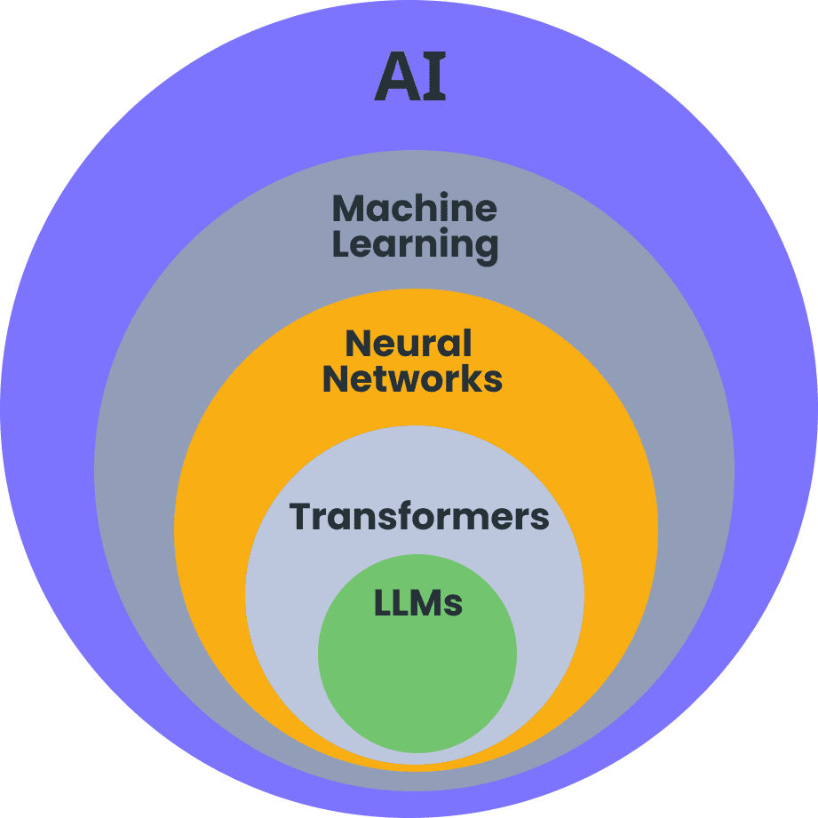
Artificial Neural Network
Artificial Neurons loosely mimic the way biological neurons in the human brain process information
Artificial Neuron is the building block of artificial neural networks
Artificial Neuron is activated in response to certain inputs and produces an output (fires)
Biological Neurons
Artificial Neurons
Information is conveyed by mean firing rate of neuron (activations as a series of brief electrical pulses )

Slide 3
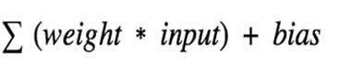
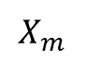
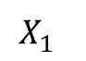
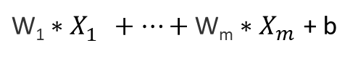
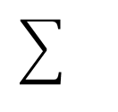
A Single Artificial Neuron (Perceptron)
Inputs Weights Bias Activation Function Outputs
b
$$X_{1}^{}$$
w1
${\text{W}\text{1}∗X}_{1}^{}+…+\text{W}\text{m}∗X_{m}^{}$ + b
…
…
A
O
$$X_{m}^{}$$
wm
An artificial neuron creates output using two components:
(1) weighted sum of inputs plus a bias
(2) activation function.
Weights and bias represent a linear function on inputs
Using the activation function it produces the output.

Slide 4
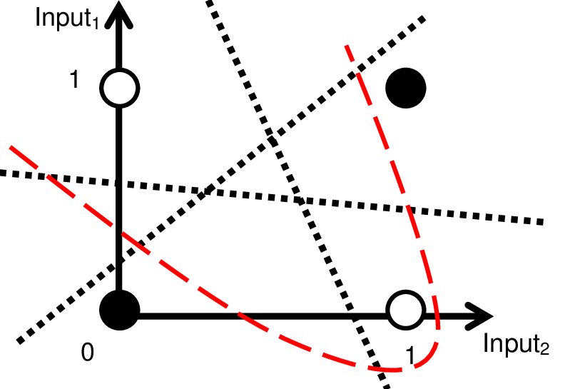
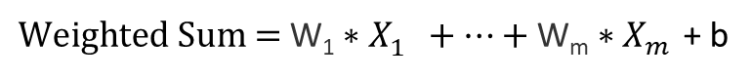
Activation Function
${\text{Weighted} \text{Sum}\text{ = }\text{W}\text{1}∗X}_{1}^{}+…+\text{W}\text{m}∗X_{m}^{}$ + b
Most of real-world relationships are non-linear
Without activation function, the output would be a polynomial linear function with less power to learn complex patterns comparing non-leaner functions
Activation functions control the output range of neurons which can be used to satisfy requirements for different layers of the neural network
There are several non-linear activation functions in neural networks which are suitable for different layers and architectures
Input x1​ | Input x2​ | Output y=x1⊕x2
0 | 0 | 0
0 | 1 | 1
1 | 0 | 1
1 | 1 | 0
If you stack only linear transformations, the result is still a linear function: y=W2​(W1​x)=(W2​W1​)x
Example: There is no linear function that can model XOR

Slide 5
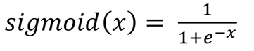
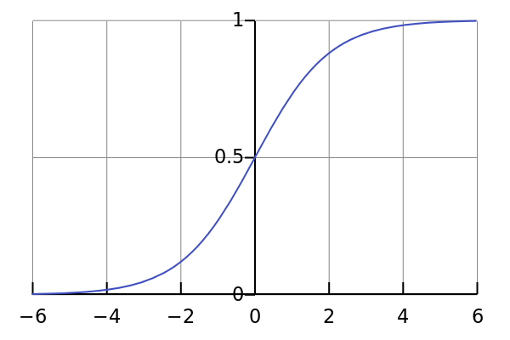
Activation Functions - Sigmoid
It is nonlinear in nature.
the output of the activation function is always going to be in range (0,1) which can represent probabilities
Sigmoid functions can be used in for binary classification

Slide 6
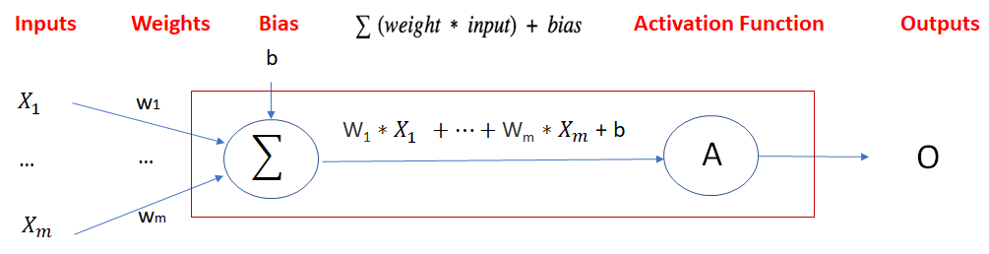
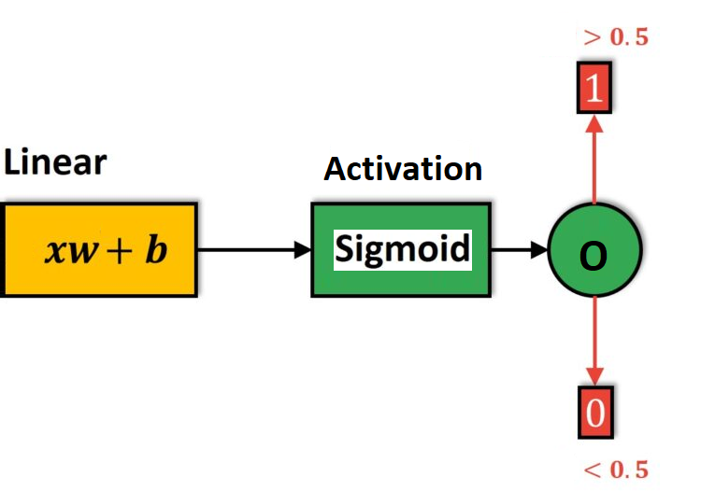
Artificial Neuron with Sigmoid Activation
An artificial neuron with Sigmoid activation can be used for binary classification as it produces a value between 0 and 1
The output of the Sigmoid function is interpreted as the probability that a given input x belongs to the positive class.
For two classes, if the value is greater than a threshold (e.g., 0.5) then it belongs to Class 1 otherwise it belongs to Class 0.
An artificial neuron with Sigmoid activation is similar to Logistic Regression model

Slide 7
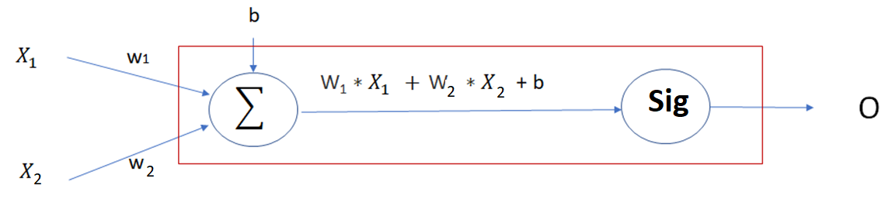
Artificial Neuron with Sigmoid - Example
Task: Predicting Sepsis (label) using the following features:
Feature 1 (x1): Severity of Fever (0-3)
Feature 2 (x2): Severity of Chills (0-3)
Suppose after training model using the training data, the weights and bias would be as follows: w1= 0.5 , w2= 0.8, b= -1.0
Training Data
O = Sigmoid (0.5×Fever + 0.8×Chills − 1.0)
Fever Severity | Chills Severity | Sepsis
3 | 1 | 1
0 | 0 | 0
1 | 2 | 1
0 | 1 | 0
2 | 3 | 1

Slide 8
Artificial Neuron with Sigmoid - Example
Probability(Sepsis ∣ Fever Severity, Chills Severity)= Sigmoid (0.5× Fever + 0.8× Chills − 1.0)
To classify new cases, we can use the trained model:
Probability(Sepsis∣2,1)= Sigmoid(0.5×2+0.8×1−1.0) = Sigmoid (1.6) ​= 0.832
Since 0.832 is greater than 0.5, the model classifies the case as Sepsis.
Probability(Sepsis∣1,0)= Sigmoid(0.5×1+0.8×0−1.0) = Sigmoid (-0.5) ​= 0.377
Since 0.377 is less than 0.5, the model classifies the case as Normal.
Fever Severity | Chills Severity | Sepsis
2 | 1 | ?
1 | 0 | ?

Slide 9
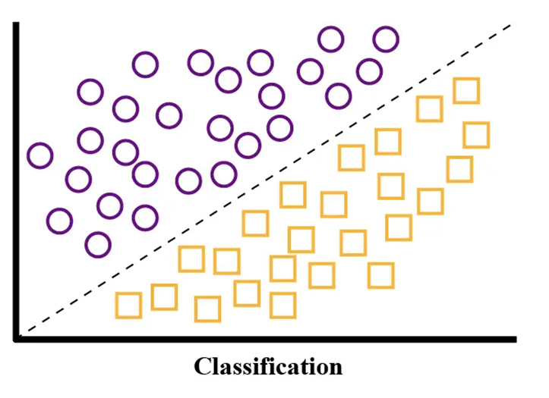
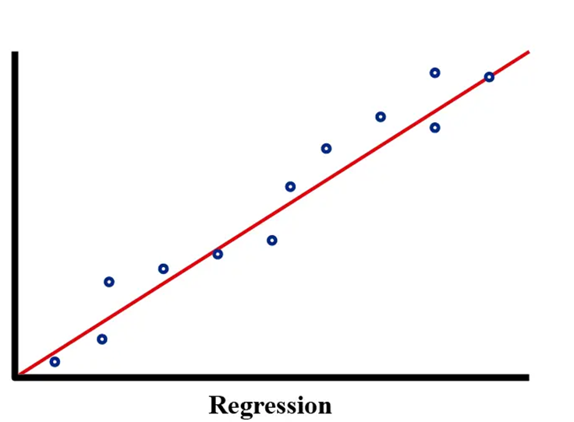
A Single Artificial Neuron - Tasks
A single artificial neuron can be used for two main tasks:
1- Binary Classification: The output of the model is a class label
Goal: To assign one of two predefined classes to an input
Example: Predicting sepsis vs normal based on fever, etc.
2- Regression: The output of the model is a continuous value
Goal: To assign a numerical value to an input
Example: Predicting house prices based on living area , etc.
For regression tasks, we typically don't use activation function since regression aims to predict unbounded real values

Slide 10
Training a Neuron – Problem Statement
The objective is to find weights and biases in a way that minimizes the error between the predicted and real (target) outputs. We need a loss function to quantify the error:
Regression Loss Functions: used in regression applications; given an input, the model predicts a corresponding continuous value.
Examples: Sum of Squared Errors(SSE), Mean Squared Error (MSE)
Classification Loss Functions: used in classification applications; given an input, the neural network produces probabilities of belonging to various classes (categorical values).
Example: Binary Cross-Entropy (Binary Classification)

Slide 11
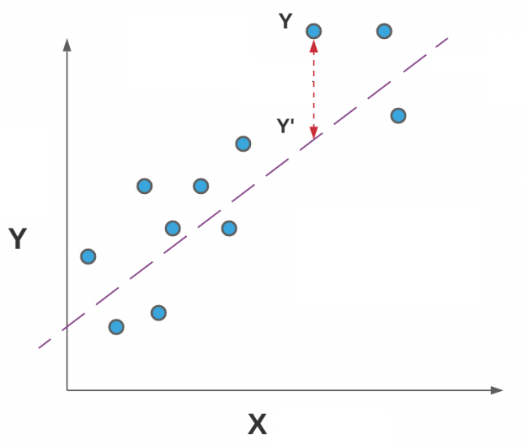
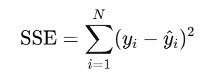
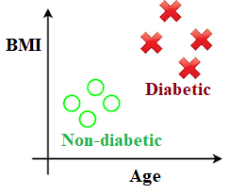
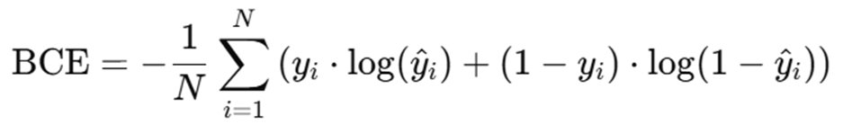
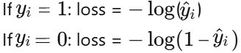
Loss Functions
Sum Squared Error:
Commonly used in regression tasks, measuring the discrepancy between predicted values and actual values.
Due to squaring, emphasizing larger errors more than smaller ones due to squaring.
Binary Cross-Entropy:
Often used in binary classification (labeled as 0 and 1) with activation functions like sigmoid
Cross-Entropy measures the difference between the predicted probabilities and the true labels
For each prediction
Notes:
labels

Slide 12
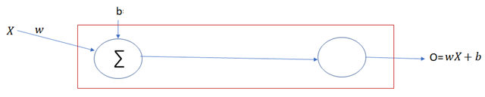

Training a Neuron – Regression Example
For a single neuron, loss function for regression task can be defined as:
In SSE positive and negative differences between predicted output and real output don’t cancel each other
To facilitate derivative operations, we can also use:
Using close-form method, we can find weights (and bias) in a way that minimize the loss
$$SSE=\text{Σ} (Real Output−Output of Neuron)^{2}$$
$E= \frac{1}{2}\text{Σ} (Real Output−Output of Neuron)^{2}$ $= \frac{1}{2}\text{Σ} (Y−O)^{2}$

Slide 13
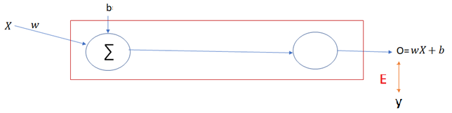
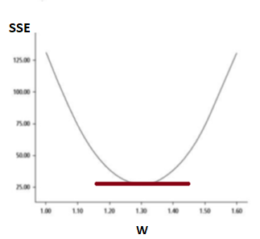
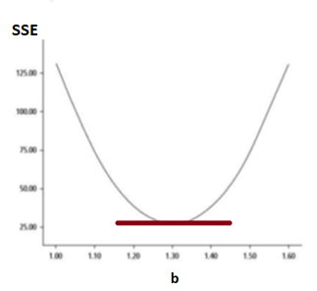
Closed-form Method - Example
o = wx + b
SSE = ½ * Σ(y — o)² = ½ * Σ(y — b — wx)²
To minimize SSE, we take the partial derivatives of SSE with respect to w and b, set them equal to zero, and solve for w and b.
A simple neuron without activation function

Slide 14
Partial Derivative
E = ½ * Σ(y — b — wx)²
Taking the partial derivative of E with respect to w:
∂E/∂w = -2 * ½ * Σx(y — b — wx) = 0
Σxy — bΣx — wΣx² = 0
w = (Σxy — bΣx) / Σx²
Taking the partial derivative of E with respect to b:
∂E/∂b = -2 * ½ *Σ(y — b — wx) = 0
Σy — nb — wΣx = 0
b = (Σy — wΣx) / n = 𝑦 ̄−w𝑥 ̄

Slide 15
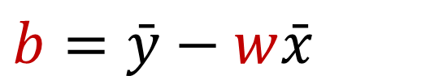
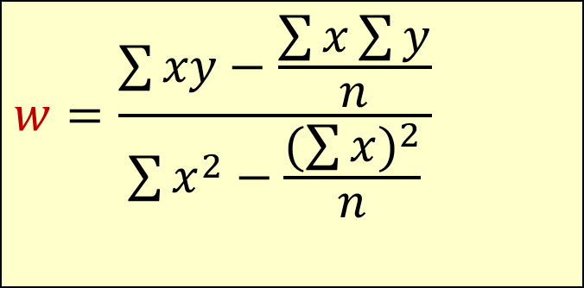

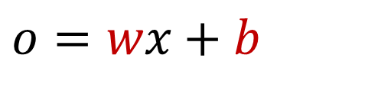
The Least Squares Equation
To minimize loss, values of w and b should be :
1) w = (Σxy — bΣx) / Σx²
2) b = (Σy — wΣx) / n
$$w=\frac{\sum{xy−\frac{\sum{x\sum{y}}}{n}}}{\sum{x^{2}−\frac{(\sum{x})^{2}}{n}}}$$
After calculation of w:
1,2 →
$$b=\bar{y}−w\bar{x}$$
2 →
After calculation of w and b:
$$w=\frac{\sum{\left(x −\bar{x}\right)(y−\bar{y})}}{\sum{{\left(x −\bar{x}\right)}^{2}}}$$
$$o=wx+b$$

Slide 16
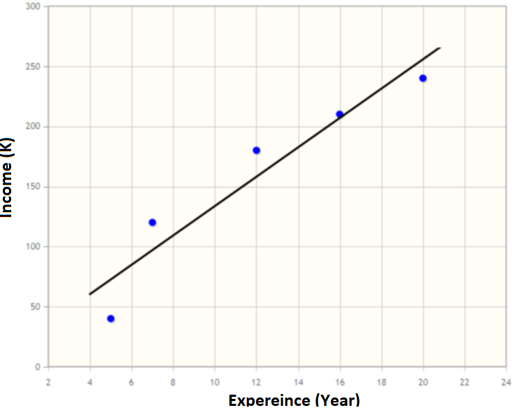
Closed Form Calculation - Example
Suppose that we want to train a regression model to predict income of employees based on their work experience
Values of w and b can be calculated using the formula in a way that minimize loss on the training data:
An artificial neuron (without activation) can be used as a simple linear regression model
Training Data
Experience (Year) | Income (K)
5 | 40
7 | 120
12 | 180
16 | 210
20 | 240
$$Income=w∗Experience+b$$

Slide 17
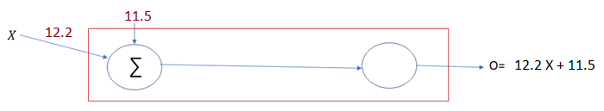
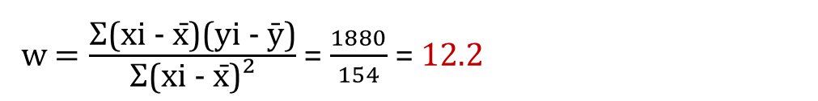
Closed Form Calculation - Example
xi | yi | xi - x̄ | yi - ȳ | (xi - x̄)(yi - ȳ) | (xi - x̄)²
5 | 40 | 5 - 12 = -7 | 40 - 158 = -118 | -7 × -118 = 826 | (-7)² = 49
7 | 120 | 7 - 12 = -5 | 120 - 158 = -38 | -5 × -38 = 190 | (-5)² = 25
12 | 180 | 12 - 12 = 0 | 180 - 158 = 22 | 0 × 22 = 0 | 0² = 0
16 | 210 | 16 - 12 = 4 | 210 - 158 = 52 | 4 × 52 = 208 | 4² = 16
20 | 240 | 20 - 12 = 8 | 240 - 158 = 82 | 8 × 82 = 656 | 8² = 64
Σx = 60 | Σy = 790 |  |  | Σ(xi - x̄)(yi - ȳ) = 1880 | Σ(xi - x̄)² = 154
x̄ = 60/5=12 | ȳ=790/5=158
w $=\frac{\text{Σ}\text{(}\text{xi}\text{ − }\text{x}\text{̄)(}\text{yi}\text{ − ȳ)}}{\text{Σ}\text{(}\text{xi}\text{ − }\text{x}\text{̄)²}}$= $\frac{1880}{154}$= 12.2
$$b=\bar{y}−w\bar{x}=158 −(12.2∗12)=11.5$$
$$Income=(12.2∗Experience)+11.5$$
Notes:
这是在演示一元线性回归用“闭式解（closed form）”手算斜率和截距的过程。
数据：有 5 组 $\left(x_{i} , y_{i}\right)$（图里把 $x$=Experience、$y$=Income）。 先求均值：$\overset{ˉ}{x}=12$，$\overset{ˉ}{y}=158$。
表格每一列含义：
$x_{i}−\overset{ˉ}{x}$、$y_{i}−\overset{ˉ}{y}$：把数据“中心化”。
$\left(x_{i}−\overset{ˉ}{x}\right)\left(y_{i}−\overset{ˉ}{y}\right)$：两者乘积，最后求和得到 。
$\left(x_{i}−\overset{ˉ}{x}{\left.)\right.}^{2}\right.$：平方，最后求和得到 。
OLS 闭式解：
$$b=\overset{ˉ}{y}−w\overset{ˉ}{x}=158−12.2×12≈11.5$$
（数值做了四舍五入，所以得到 11.5。）
回归方程（预测收入）：
$$\text{Income} = 12.2×\text{Experience}+11.5$$
直观上：每多 1 年经验，预测收入增加约 12.2 个单位；没有经验时的基线收入约 11.5。

Slide 18
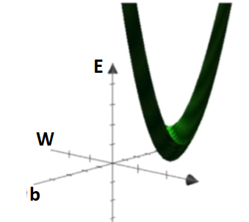
Approaches to Minimize Loss
The closed form is computationally expensive (for large number of parameters in neural networks it is not feasible)
For many computationally expensive problems, greedy approaches can provide reasonable solutions at much lower computational cost
A greedy approach solves a problem step by step by making the best (locally optimal) decision at each step (not necessarily global optimal decision)
There are also greedy approaches to estimate optimal weights (and bias) with less computation cost.
One common greedy approach is gradient descendent.
It is an iterative approach tries to move towards smaller loss

Slide 19
Gradient Descent - Intuitive
Gradient is the vector of partial derivatives with respect to each parameter:
Zero slope of gradient → it is Minimum point (sometimes local minimum)
Big slope of gradient It→ is far from zero slope (which we are looking for) → we need bigger decrease
Small slope of gradient → It is near to zero slope (which we are looking for) → we need smaller decrease (not passing by)
1,2,3 → A greedy idea:
In each step, subtract a value proportional to last gradient (bigger value for big gradient and smaller value for small gradient) to get closer to minimum point.

Slide 20
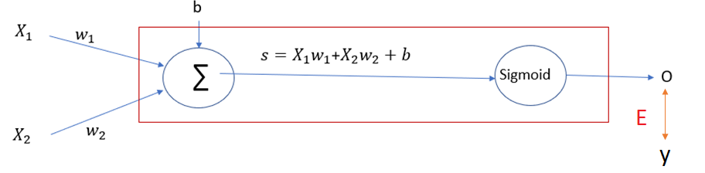
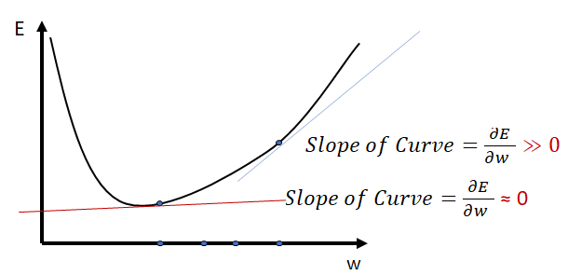

Learning Steps
It starts with random initial numbers for parameters and iteratively updating the model’s parameters in the negative gradient direction.
In each iteration of the algorithm, the gradient of the loss function with respect to each parameter is computed.
The size of the step is controlled by the learning rate, which determines how quickly the algorithm moves towards the minimum.
The process is repeated until the gradient (slope) becomes close to zero or after a predefined number of steps
$$w_{i}=w_{i}−Learning rate∗\frac{∂E}{∂w_{i}}$$

Slide 21
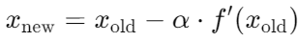

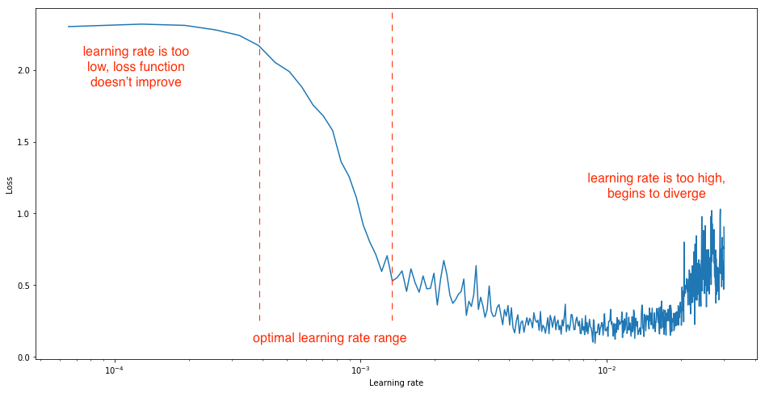
Learning Rate
Learning rate is a hyperparameter that determines how big a step is taken.
A too high learning rate will make the learning jump over minima
A too low learning rate will either take too long to converge or get stuck in a local minimum
Optimal learning rate depends on the model and can be determined using the validation data

Slide 22
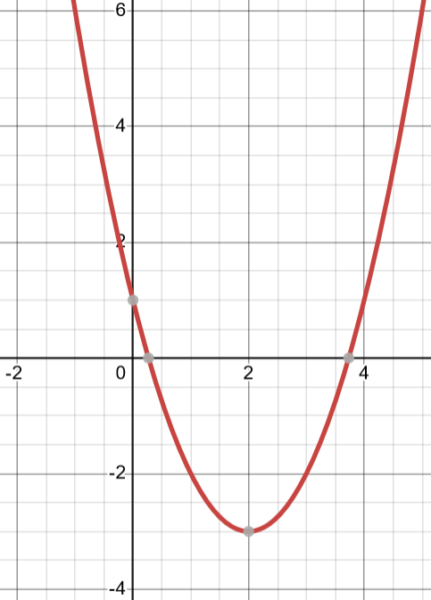
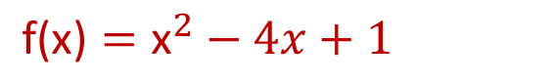
Gradient Descent – Example1
Suppose that we want to find the parameter x in a way that minimize f(x) (can be loss):
1- Calculate the derivative
The derivative (or gradient) of the function is: f′(x)=2x−4
2- Choose a starting point
Start at x0=9. (This is an initial guess for the minimum)
3- Choose a learning rate
learning rate α=0.1
$$\text{f}\text{(}\text{x}\text{)}={\text{x}}^{2}−4x+1$$
x

Slide 23
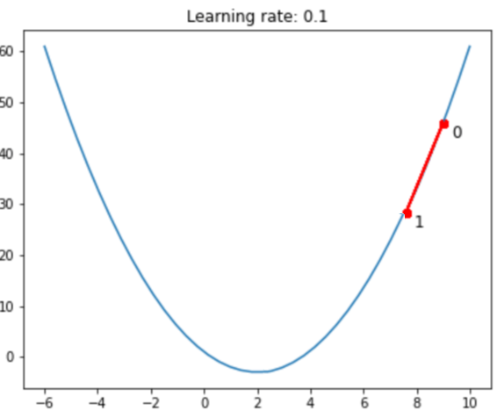
Gradient Descent – Example1
4- Perform the gradient descent step
To update value of x, the formula is used:
Iteration 1:
Starting point: x0=9
f′(x)=2x−4 → Gradient at x0: f′(9)=2×9−4=14
Update x: x1= x0 – α*f′(x0) = 9 − 0.1×(14)=7.6

Slide 24
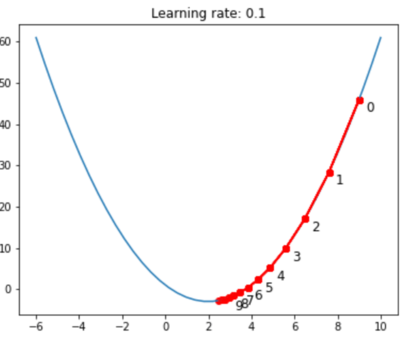
Gradient Descent – Example1
Iteration 2:
x1=7.6
f′(x)=2x−4 → f′(x1)=2(7.6)−4=15.2−4=11.2
Update x: x2= x1 – α*f′(x1) =7.6−0.1×11.2=7.6−1.12=6.48
Iteration 3:
x2=6.48
f′(x)=2x−4 → f′(x2)=2(6.48)−4=12.96−4=8.96
Update x: x3 = x2 – α*f′(x2) =6.48−0.1×8.96=6.48−0.896=5.584
Iteration 4:
x3=5.584
f′(x)=2x−4 → f′(x3)=2(5.584)−4=11.168−4=7.168
Update x: x4 = x3 – α*f′(x3) =5.584−0.1×7.168=5.584−0.7168=4.8672
Iteration 5:
x4=4.8672
f′(x)=2x−4 → f′(x4)=2(4.8672)−4=9.7344−4=5.7344
Update x: x5 = x4 – α*f′(x4) =4.8672−0.1×5.7344=4.8672−0.57344=4.29376
…
5- Process continues till it gets close enough to the minimum point
Notes:
这页在演示**梯度下降（Gradient Descent）**如何用固定学习率把一元函数最小化。
目标函数 给定 $f\left(x\right)=x^{2}−4x+C$（常数 $C$不影响最小值）， 其导数 $f^{′}\left(x\right)=2x−4$。抛物线的最小点在 $x^{\text{\backslash ∗}}=2$。
更新公式（学习率 $α=0.1$）
$$x_{k+1}=x_{k}−α f^{′}\left(x_{k}\right)=x_{k}−0.1 \left(2x_{k}−4\right)$$
从 $x_{0}=9$出发的迭代（图右红点）
Iter 1 → $x_{1}=9−0.1\left(18−4\right)=7.6$
Iter 2 → $x_{2}=7.6−0.1\left(15.2−4\right)=6.48$
Iter 3 → $x_{3}=6.48−0.1\left(12.96−4\right)=5.584$
Iter 4 → $x_{4}=5.584−0.1\left(11.168−4\right)=4.8672$
Iter 5 → $x_{5}=4.8672−0.1\left(9.7344−4\right)=4.29376$ …不断靠近最小点 2（图中红点逐步滑向抛物线最低处）。
直观理解
每一步都沿着负梯度方向走一小步（“下坡”）。
学习率 $α$决定步长：
太大 → 可能震荡/发散；
太小 → 收敛很慢。
这个示例是凸二次函数，所以一定收敛到全局最小值 $x=2$。
推广到多维 若 $f\left(w\right)$关于向量 $w$，更新为
$$w_{k+1}=w_{k}−α ∇f\left(w_{k}\right)$$
逻辑与上面完全相同：用梯度（偏导数组成的向量）指引“下坡”。
需要的话我可以给你一个简短的 Python 代码，画出不同学习率下的收敛轨迹对比。

Slide 25
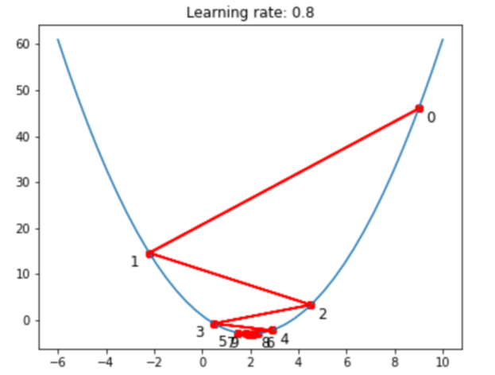
Gradient Descent – Example2
by taking a learning rate of 0.8 and starting point at x=9
Iteration 1:
Starting point: x0=9
f′(x)=2x−4 → Gradient at x0: f′(9)=2×9−4=14
Update: x1= x0 – a*f′(x0) = 9 − 0.8×(14)=-2.2
Iteration 2:
x1= -2.2
f′(x)=2x−4 → Gradient at x1: f′(-2.2)=2×-2.2−4= -8.4
Update: x2= x1 – a*f′(x1) = -2.2 − 0.8×(-8.4)= 4.52
Iteration 3:
…

Slide 26
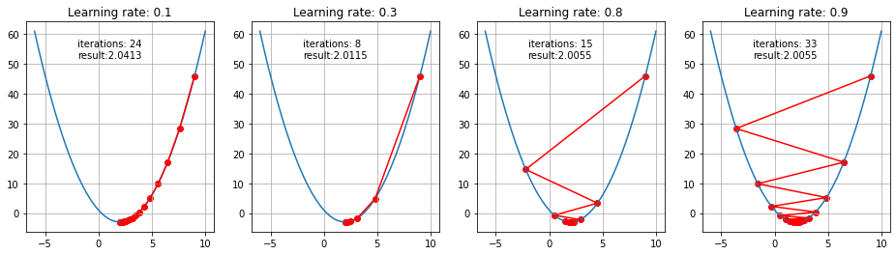
Effect of Learning Rate
Steps taken by GD for small and big learning rates:

Slide 27
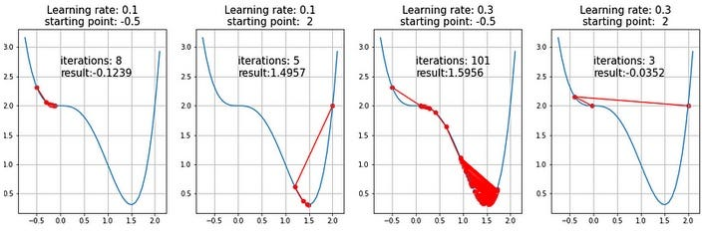
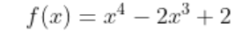
Saddle Points
Saddle Points: These are points where the gradient is near to zero but are not a minimum. Gradient descent can get stuck at these points, leading to slow convergence or failure to find the optimal solution.
Investigation of saddle points and how to escape from saddle points is a subject of ongoing studies and various solutions were proposed

Slide 28
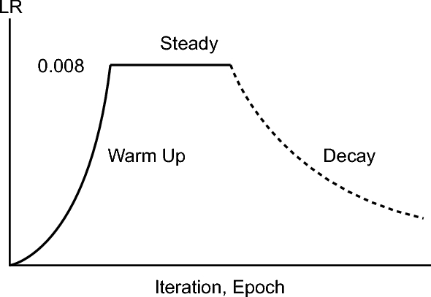
Variable Learning Rate
Training large-scale models requires adjusting billions / trillions of parameters with gradient descent and a fixed learning rate usually is not effective.
Early Training: Weights are far from optimal, and a larger learning rate helps get to the minimum more quickly.
Later Training: A smaller learning rate allows fine-tuning around the minimum and prevents overshooting.
Escaping Saddle Points: A variable learning rate can also help escape the saddle points.
Combine Warmup and Decay (most common for LLMs):
Gradually increasing (warming up) to the target learning rate
Keep LR fixed at its peak for some fraction of training (steady)
Once starts converging, decaying the learning rate over time (decay)

Slide 29
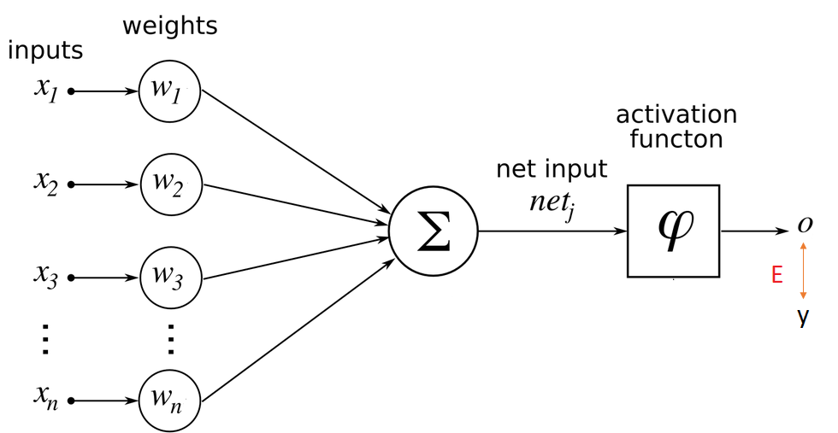
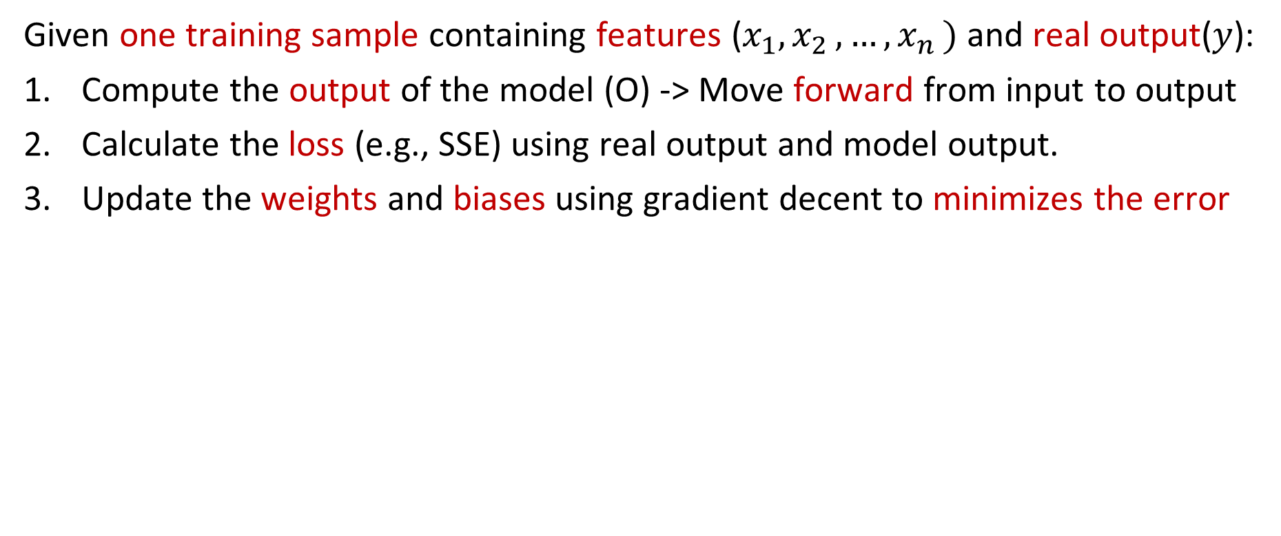

Training of a Single Neuron - Steps
Given one training sample containing features ($x_{1}{,x}_{2}, …{,x}_{n})$ and real output($y$):
Compute the output of the model (O) -> Move forward from input to output
Calculate the loss (e.g., SSE) using real output and model output.
Update the weights and biases using gradient decent to minimizes the error
$$w_{i}=w_{i}−Learning rate∗\frac{∂E}{∂w_{i}}$$

Slide 30
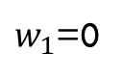
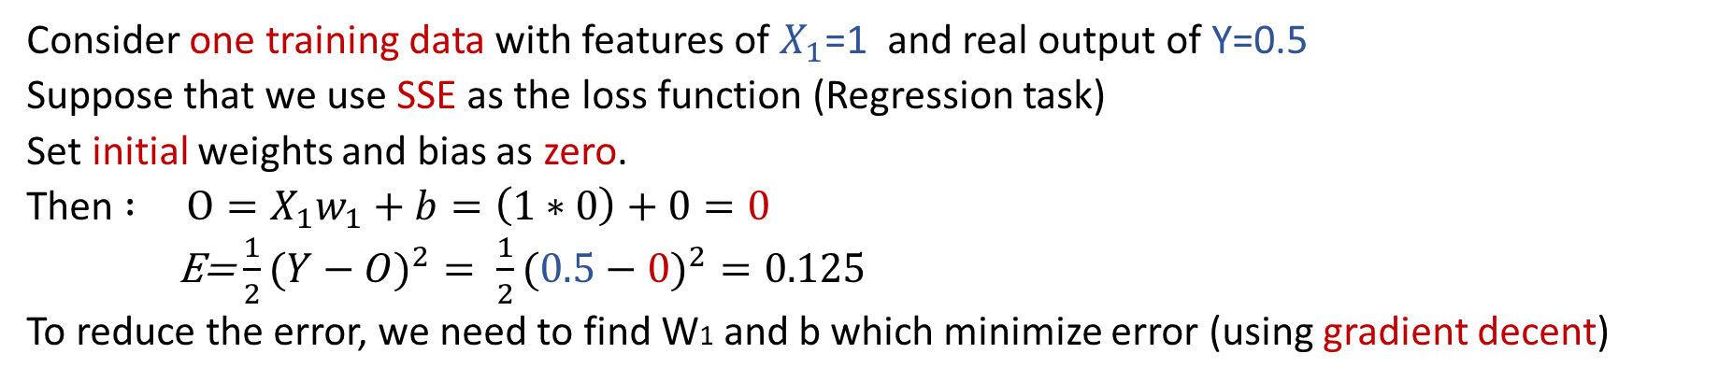
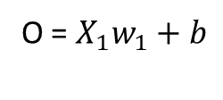
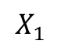
Training of a Single Neuron – Regression Example
b=0
$$X_{1}$$
$w_{1}$=0
∑
O = $X_{1}w_{1}+b$
No Activation Function
Consider one training data with features of $X_{1}$=1 and real output of Y=0.5
Suppose that we use SSE as the loss function (Regression task)
Set initial weights and bias as zero.
Then $: O=X_{1}w_{1}+b=\left(1∗0\right)+0=0$
E=$\frac{1}{2}(Y−O)^{2}= \frac{1}{2}(0.5−0)^{2}=0.125$
To reduce the error, we need to find W1 and b which minimize error (using gradient decent)

Slide 31


Update Weights using Gradient Decent
$W_{i}$new= $W_{i}$old - Learning_Rate* $\frac{∂E}{∂W_{i}}$
We can use chain rule to calculate a derivative:
$\frac{dz}{dx}=\frac{dz}{dy}\frac{dy}{dx}$
Therefore:
$$\frac{∂E}{∂W_{1}}=\frac{∂E}{∂O}\frac{∂O}{W_{1}}$$
$\frac{∂E}{∂b}=\frac{∂E}{∂O}\frac{∂O}{∂b}$
Learning rate = 0.1
Notes:
这是在说明用梯度下降（Gradient Descent）更新权重，并用**链式法则（chain rule）**把“损失对参数的导数”拆开来算。
模型
右图是一个最简单的“单神经元/线性回归”：
$$O=x_{1}w_{1}+b \left(\text{无激活函数}\right)$$
损失（误差）记为 $E$（比如平方误差）。
更新公式（学习率 = 0.1）
$$w_{1}^{\text{new}}=w_{1}^{\text{old}}−α\frac{∂E}{∂w_{1}}, b^{\text{new}}=b^{\text{old}}−α\frac{∂E}{∂b}$$
用链式法则求梯度
$$\frac{∂E}{∂w_{1}}=\frac{∂E}{∂O}⋅\frac{∂O}{∂w_{1}}=\frac{∂E}{∂O}⋅x_{1}$$
$$\frac{∂E}{∂b}=\frac{∂E}{∂O}⋅\frac{∂O}{∂b}=\frac{∂E}{∂O}⋅1$$
若用平方误差 $E=\frac{1}{2}\left(O−y{\left.)\right.}^{2}\right.$，则
$$\frac{∂E}{∂O}=O−y$$
于是得到常见的一步更新式：
$$\boxed{ w_{1}←w_{1}−α\left(O−y\right)x_{1}, b←b−α\left(O−y\right) }$$
直觉：
$O−y$是“预测偏差”；
乘上 $x_{1}$（或 1）就是该参数对输出的影响强度；
用学习率 $α$（这里 0.1）控制步长，沿负梯度方向把参数往“让误差变小”的方向推一点点。

Slide 32


Training of a Single Neuron - Example
$o=X_{1}w_{1}$+ $b$
𝐸 $= \frac{1}{2}(Y−O)^{2}$
$X_{1}$=1, Y=0.5
O= 0
Learning rate = 0.1
$\frac{∂E}{∂W_{1}}=\frac{∂E}{∂O}\frac{∂O}{∂W_{1}}$
$\frac{∂E}{∂O}$ = $\frac{∂(\frac{1}{2}(Y−O)^{2})}{∂O}=2∗\frac{1}{2}\left(−1\right)\left(Y−O\right)=O−Y=0 −0.5=−0.5$
$\frac{∂o}{∂W_{1}}$ = $\frac{∂{(X}_{1}w_{1}+b)}{∂W_{1}}= X_{1}$ = 1
$\frac{∂E}{∂W_{1}}=\frac{∂E}{∂O}\frac{∂O}{∂W_{1}}=−0.5∗1 =−0.5$
Now we can calculate new value of $w_{1}$:
$w_{1}new=w_{1}old−Learning_Rate∗\frac{∂E}{∂W_{1}}$ = 0 – 0.1*-0.5 = 0.05

Slide 33

Training of a Single Neuron - Example
$o=X_{1}w_{1}$+ $b$
𝐸 $= \frac{1}{2}(Y−O)^{2}$
$X_{1}$=1, Y=0.5
O= 0
Learning rate = 0.1
$\frac{∂E}{∂b}=\frac{∂E}{∂O}\frac{∂O}{∂b}$
$\frac{∂E}{∂O}$ = $\frac{∂(\frac{1}{2}(Y−O)^{2})}{∂O}=2∗\frac{1}{2}\left(−1\right)\left(Y−O\right)=O−Y=0 −0.5=−0.5$
$\frac{∂o}{∂b}$ = $\frac{∂{(X}_{1}w_{1}+b)}{∂b}=$1
$\frac{∂E}{∂b}=\frac{∂E}{∂O}\frac{∂O}{∂b}=−0.5∗1 =−0.5$
Now we can calculate new value of $b$:
$b_new=b_old−Learning_Rate∗\frac{∂E}{∂b}$ = 0 – 0.1*-0.5 = 0.05
Notes:
单个神经元的训练 —— 示例
$$\frac{∂E}{∂w_{1}}=\frac{∂E}{∂o} \frac{∂o}{∂w_{1}}$$
\frac{\partial E}{\partial o} = \frac{\partial}{\partial o}!\left(\tfrac12 (Y-O)^2\right) = 2 \cdot \tfrac12 \cdot (-1)(Y-O) = O - Y = 0 - 0.5 = -0.5 ]
\frac{\partial o}{\partial w_1} = \frac{\partial (x_1 w_1 + b)}{\partial w_1} = X_1 = 1 ]
因而：
$$\frac{∂E}{∂w_{1}}=\frac{∂E}{∂o} \frac{∂o}{∂w_{1}}=−0.5×1=−0.5$$
现在可以计算 $w_{1}$的新值：
$$w_{1}^{\text{new}}=w_{1}^{\text{old}}−\text{Learning}\text{_}\text{Rate}⋅\frac{∂E}{∂w_{1}}=0−0.1×\left(−0.5\right)=0.05$$
右侧给定条件： $o=x_{1}w_{1}+b$；$E=\frac{1}{2}\left(Y−O{\left.)\right.}^{2}\right.$；$X_{1}=1$，$Y=0.5$，$O=0$，学习率 $=0.1$。

Slide 34



Training of a Single Neuron - Example
b=0.05
$$X_{1}$$
$w_{1}$=0.05
∑
O = $X_{1}w_{1}+b$
No Activation Function
After calculation of all parameters the new parameters are updated in the model:
$$w_{1}\text{=0}\text{.05, }\text{b}\text{=0.0}\text{5 ,}{ X}_{1}\text{=1, }\text{Y}\text{=0.5 }→ O=X_{1}w_{1}+b = \left(1∗0.05)+(0.05\right)=0.1$$
$$\text{E}\text{=} \frac{1}{2}(Y−O)^{2}= \frac{1}{2}(0.5−0.1)^{2}=0.08 (it was 0.125)$$
This process is repeated until the error is sufficiently small (below a threshold) or a maximum number of iteration is reached or there is no significant decrease in error.
Gradient descent can get stuck in the local optimal, therefore, sometimes the results are not globally optimal.
Notes:
单个神经元的训练 —— 示例
（右图）当前参数：$w_{1}=0.05, b=0.05$。 输入：$X_{1}=1$，目标：$Y=0.5$。 输出：$O=X_{1}w_{1}+b=\left(1×0.05\right)+0.05=0.1$。
误差：
$$E=\frac{1}{2}\left(Y−O{\left.)\right.}^{2}=\frac{1}{2}\left(0.5−0.1{\left.)\right.}^{2}=0.08 \left(\text{之前是} 0.125\right)\right.\right.$$
说明：
该过程会重复进行，直到误差足够小（低于某个阈值），或达到最大迭代次数，或者误差不再显著下降为止。
梯度下降可能会陷入局部最优，因此有时得到的结果并不是全局最优。

Slide 35

Neural Networks
A multi-level neural network is a neural network that consists of multiple levels (layers) of neurons. Each level can have multiple neurons
There are several types of neural networks, each designed for specific tasks and applications:
Feedforward Neural Networks (FNN) : Classification, regression tasks
Recurrent Neural Networks (RNN): Time series prediction, natural language processing (NLP)
Transformer Networks: Large Language Model’s tasks
…

Slide 36

Feedforward Neural Networks
A Feedforward neural network is a neural network that connections between neurons in different levels do not form loops.
Information moves in one direction (forward) from input nodes, through hidden nodes, to output nodes.
Neural Neurons can learn complex functions and non-linear relationships.

Slide 37

Feedforward Neural Networks
The input layer is fed the raw input and passes this information on to the next layer in the artificial neural network (typically a hidden layer).
The neurons in the hidden layer process the information, then pass the results on to the next layer (another hidden or output layer) of artificial neurons.
The output layer creates results for regression (continuous values) and classification (classes).
Hidden layers allow the network to learn complex non-linear relationships between the inputs and outputs.

Slide 38






Activation Functions - Softmax
$$\text{Softmax}(x_{i})=\frac{e^{x_{i}}}{\sum_{k=1}^{K}{e^{x_{k}}}}$$
The output of the softmax is always in range (0,1)
Divides by the sum of all outputs, allows for probability distribution (Sum of all outputs is always 1)
Useful for multi-class classification problems on output layer of neural networks.
Softmax
Sig
$$0.84$$
Class1
Class1
Sig
$$0.62$$
Class2
Class2
Sig
$$0.54$$
Class3
Class3

Slide 39


Activation Functions - ReLu
The output of the activation function is always going to be in range (0,inf)
ReLu is non-linear in nature and combinations of ReLu are also non-linear
Using a sigmoid will cause almost all neurons to activate, but in ReLu almost 50% of the network yields 0 (inactive/not firing). This means the network is lighter.
ReLu is less computationally expensive than sigmoid because it involves simpler mathematical operations.
ReLu is a common activation function for hidden layers.
ReLu(x) = max(0,x)

Slide 40

Selection of Activation Function
Different activation function can be used for different layers of neural networks:
Sigmoid can be used for the output layer in binary classification.
Softmax is usually used for the output layer in multi-class classification.
ReLU works most of the time as a general approximator in hidden layers
There are also many other activation functions such as Tanh, GeLU, etc. can be used to address different issues in Neural Networks

Slide 41
Neural Network Model – Inference Example
Input Layer
(Three Neurons)
Hidden Layer
(Two Neurons)
Output Layer
(One Neuron)
Age
34
-0.4
H1
0.2
Σ
O1
0.5
0.1
0.83
(Probability of Diabetes)
BMI
29
Σ
0.3
0.8
0.1
Σ
-0.4
H2
Glucose
140
Activation
(e.g., ReLU)
Activation
(e.g., Sigmoid)
Inputs
Weights
Weights
Outputs
H1 = Relu (34 * -0.4 + 29 * 0.1 + 140*0.1) = max(0,3.3) = 3.3
H2 = Relu (34 * 0.2 + 29 * 0.3 + 140*-0.4)= max(0,-40.5) = 0
O1 = Sigmoid (3.3 * 0.5 + 0 * 0.8) = 0.83
Notes:
这是一个“前向推理”的神经网络示例，预测“是否患糖尿病”的概率。图里只有一层隐藏层，计算过程完全展开了：
1) 输入层（3 个特征）
Age=34，BMI=29，Glucose=140 每条连线上的数字是权重（weight），表示这个输入对下一层神经元的影响大小。
2) 隐藏层（2 个神经元，激活函数用 ReLU） 每个隐藏神经元先把来自各输入的“加权和”求出来（蓝色Σ），再过 ReLU：ReLU(x)=max(0, x)。
H1 的加权和：34*(-0.4) + 29*(0.1) + 140*(0.1) = -13.6 + 2.9 + 14 = 3.3 ReLU(3.3) = 3.3（正数，保留）
H2 的加权和：34*(0.2) + 29*(0.3) + 140*(-0.4) = 6.8 + 8.7 - 56 = -40.5 ReLU(-40.5) = 0（负数被置为 0）
3) 输出层（1 个神经元，激活函数用 Sigmoid） 隐藏层到输出层也有权重：H1→0.5，H2→0.8。先求加权和，再过 Sigmoid。
加权和：3.3*0.5 + 0*0.8 = 1.65
Sigmoid(1.65) = 1/(1+e^-1.65) ≈ 0.83
4) 含义 输出 0.83 表示模型认为“该样本为糖尿病的概率≈83%”。
H2 因为 ReLU 把负值截断成 0，对结果没有贡献；
H1 为正且权重 0.5，推动概率升高。
要点回顾
权重：连线上的系数，学习得到；
Σ：把输入做加权求和；
ReLU：负数变 0，正数保持；
Sigmoid：把实数压到 (0,1)，可解释为概率。

Slide 42


Matrix Representation of Neural Networks
To realize a neural network, input data is often represented as vectors or matrices, and the layers of the network perform operations like matrix multiplication, addition, and application of activation functions.
Notes:
神经网络的矩阵表示
为了实现一个神经网络，输入数据通常表示为向量或矩阵。网络的各层会执行矩阵乘法、加法以及激活函数的应用等操作。
右图示意：输入 $x_{1},x_{2},x_{3},x_{4}$经过权重 $w_{ij}$连接到三个隐藏/输出神经元，得到激活值 $a_{1},a_{2},a_{3}$。
下面是矩阵形式：
$$\left[\begin{matrix}w_{11} & w_{12} & w_{13} & w_{14} \\ w_{21} & w_{22} & w_{23} & w_{24} \\ w_{31} & w_{32} & w_{33} & w_{34}\end{matrix}\right]⋅\left[\begin{matrix}x_{1} \\ x_{2} \\ x_{3} \\ x_{4}\end{matrix}\right]=\left[\begin{matrix}w_{11}x_{1}+w_{12}x_{2}+w_{13}x_{3}+w_{14}x_{4} \\ w_{21}x_{1}+w_{22}x_{2}+w_{23}x_{3}+w_{24}x_{4} \\ w_{31}x_{1}+w_{32}x_{2}+w_{33}x_{3}+w_{34}x_{4}\end{matrix}\right] \underset{→}{ \text{激活} } \left[\begin{matrix}a_{1} \\ a_{2} \\ a_{3}\end{matrix}\right]$$
$w_{ij}$：从输入 $x_{j}$到第 $i$个神经元的权重
“activation（激活）”：对线性组合应用激活函数（如 ReLU、Sigmoid 等），得到输出 $a_{i}$。

Slide 43

Partially vs Fully Connected Layer
A Fully Connected (FC) layer, also known as a dense layer, is a type of layer used in artificial neural networks where each neuron or node from the previous layer is connected to each neuron of the current layer.
Fully Connected (Dense)
Partially Connected (Sparse)
Notes:
这页在说明：全连接层（Fully Connected / Dense） 和 部分连接层（Partially Connected / Sparse） 的区别。
概念
全连接层：上一层的每个神经元都与下一层的每个神经元相连（左图）。
参数量：若上一层有 $m$个节点、下一层有 $n$个节点，权重数 = $m×n$（外加 $n$个偏置）。
部分连接层：只保留部分连接（右图），即某些节点之间没有边。
参数量显著少于全连接；连接结构可以是手工设计或通过稀疏化/正则得到。
对比与取舍
表达力：全连接最灵活，但容易过拟合、参数多、计算重。
效率：部分连接更轻量、更快、内存更省。
先验与归纳偏置：部分连接常结合结构化假设（局部性、共享等），比如：
卷积层就是一种“稀疏+权重共享”的部分连接：每个输出只看输入的局部感受野。
图神经网络、注意力的稀疏模式也属于部分连接思想。
泛化：在数据量有限时，稀疏连接/更少参数通常更能泛化。
什么时候用
用全连接：作为网络尾部分类头、或需要整合全局特征时（例如从高维特征到类别概率）。
用部分连接：输入有局部结构/拓扑（图像、时序、图数据），或希望降低参数量、提升速度、减少过拟合时。
一句话：全连接=所有人都认识所有人；部分连接=只和需要的人连线。选择哪种，取决于任务结构与效率/泛化的权衡。

Slide 44
Parameters of Artificial Neural Network
A neural network consists of layers of artificial neurons and connections between them (trainable parameters).
Each connection is associated with a weight.
Training of a neural network is to get to the right weights (and biases) such that the error across the training data is minimized.
Input
layer
Hidden
layer 1
Hidden
layer 2
Hidden
layer 3
Output
layer
Number of trainable parameters =
3*4 + 4*3 + 3*4 + 4* 2 = 44
If there are biases those also should be added to this number

Slide 45


Training Neural Network vs Single Neuron
In single Neuron we just need to optimize weights and biases of a single neuron
In neural network we need to optimize weights and biases of neurons in several levels, and each level depends on the output of the previous level.

Slide 46


Backward Propagation
The goal of backpropagation is to optimize the weights in a way that generates outputs close to target outputs.
To optimize the output, we need to adjust corresponding weights also output from the last layer.
To adjust the output from last layer we need to adjust corresponding weights also output from the previous layer, and so on ….
So, the method that was suggested was to take the errors at the output layer and proportionally propagate them backwards to the hidden layer.
Backpropagation accelerate calculation of gradient decent efficiently by reusing calculations using chain rule:
Notes:
这是在讲反向传播（Backpropagation）：用链式法则把“输出层的误差”一层一层地传回去，计算每个权重对损失的影响，从而更新权重、让模型输出更接近目标。
核心思想
前向传播：输入 → 各层线性变换+激活 → 得到预测 $\hat{y}$，计算损失 $L\left(\hat{y} , y\right)$。
反向传播：从输出层开始，按链式法则计算梯度，把误差往前传：
$$\frac{∂L}{∂θ_{\text{earlier}}}=\frac{∂L}{∂θ_{\text{later}}}⋅\frac{∂θ_{\text{later}}}{∂θ_{\text{earlier}}}$$
更新权重（梯度下降）：
$$θ←θ−η \frac{∂L}{∂θ}$$
其中 $η$是学习率。
为何“高效”
复用中间结果（前向时算的加权和、激活；反向时算的梯度），避免重复计算 → 动态规划式的效率提升。
每层只需用到下一层的“误差项”，所以能层层回传，复杂模型也能训练。
常见公式（全连接层）
记第 $l$层线性输入 $z^{\left(l\right)}=W^{\left(l\right)}a^{\left(l−1\right)}+b^{\left(l\right)}$，激活 $a^{\left(l\right)}=f\left(z^{\left(l\right)}\right)$。
输出层误差：$δ^{\left(L\right)}=∇_{a^{\left(L\right)}}L ⊙ f^{′}\left(z^{\left(L\right)}\right)$
隐藏层误差：$δ^{\left(l\right)}=\left(W^{\left(l+1{\left.)\right.}^{⊤}\right.}δ^{\left(l+1\right)}\right)⊙f^{′}\left(z^{\left(l\right)}\right)$
参数梯度： $$\frac{∂L}{∂W^{\left(l\right)}}=δ^{\left(l\right)}(a^{\left(l−1\right)}{\left.)\right.}^{⊤} \frac{∂L}{∂b^{\left(l\right)}}=δ^{\left(l\right)},$$
一句话版
先前向算出损失，再用链式法则把输出层误差逐层往回传，得到每个权重的梯度，最后用梯度下降更新权重；之所以快，是因为反向传播复用前向/后向的中间计算结果。

Slide 47

Dynamic Programming
Dynamic programing turns problems that are intractable into problems that are efficiently solvable:
Breaking tasks into overlapping subtasks
Storing results of subtasks to avoid recomputing
Handling the task efficiently using the results of the subtasks
Backpropagation:
Starts calculation of derivatives from the output layer
Compute derivatives of each layer using the chain rule
Chain rule uses the derivatives of next layers (closer to output)
These derivatives were already calculated in previous steps

Slide 48

Deep NN vs Shallow NN
Efficiency:
A neural network with two hidden layer can approximate any function, but it may require an exponentially large number of neurons to represent complex functions on high-dimensional data.
Deep networks can represent complex functions more efficiently by stacking layers.
Hierarchical Feature Learning:
Each layer in a deep network learns more complex features by combining features from the last layer.
Ease of Training in Backpropagation:
In deep NN, each layer uses calculations of gradients from subsequent layers through the chain rule.
Training a shallow network with a large number of neurons can be challenging (minimizing loss in high-dimensional space is challenging)
Notes:
深层神经网络（Deep NN） vs 浅层神经网络（Shallow NN）
效率（Efficiency）：
具有 两层隐藏层 的神经网络在理论上可以逼近任何函数，但在高维数据上表示复杂函数时，可能需要指数级数量的神经元。
深层网络通过堆叠多层，能更高效地表示复杂函数。
分层特征学习（Hierarchical Feature Learning）：
深层网络的每一层都会在上一层特征的基础上进行组合，从而学习到更复杂的特征。
反向传播中的可训练性（Ease of Training in Backpropagation）：
在深层网络中，各层可以通过**链式法则（chain rule）**利用后续层的梯度计算来更新参数。
训练一个浅层但非常宽（神经元很多）的网络会更困难——在高维空间里最小化损失更具挑战。
（底部两图：左为“浅层但很宽”的网络，右为“多层较窄”的深层网络。）

Slide 49


Training Steps
forward propagation.
Step1:
Each training input is loaded into the neural network in a process called forward propagation.
Step2:
Once the model has produced an output, this predicted output is compared against the given real output (target) in backpropagation, the weights of the model are then adjusted using gradient decent to produce a result closer to the target output.
Backward propagation
Notes:
训练步骤（Training Steps）
Step 1： 把每个训练输入送入神经网络，这个过程叫做前向传播（forward propagation）。 （右图上方：输入经过各层，得到输出与损失 $L$。）
Step 2： 当模型产生输出后，把这个预测输出与给定的真实输出（目标）进行比较；在反向传播（backpropagation）中，根据误差来调整权重，使用**梯度下降（gradient descent）**使结果更接近目标。 （右图下方：绿色箭头表示误差从输出层向前传递，红色表示各层权重 $W^{1},W^{2},…$被更新。）

Slide 50


Training Neural Network - Method
Initialize the weights $W_{0}^{}, W_{1}^{}, ……, W_{k}^{}$ (e.g., using random small values)
Training iterations:
For each training data $(x^{\left(i\right)},y^{(i)}$), using forward propagation to compute the neural network output
Compute the loss $E$ (various definitions)
Use backward propagation and chain rule to compute$\frac{∂E}{∂W_{k}}$for each weight $W_{k}$
Update $W_{k}$=$W_{k}−LearningRate ∗\frac{∂E}{∂W_{k}}$
Repeat until termination criteria are satisfied

Slide 51

Training Neural Network - Example
Given the following initial weights and Sigmoid as activation function for the network and one training data with features of 0.05 (x1) and 0.10 (x2) and real outputs of 1 (Class 1).

Slide 52
Forward Propagation
h1_in = i1*w1 + i2*w2
= 0.15 * 0.05 + 0.25*0.1
= 0.325
h1_out = Sigmoid(0.325) = 0.5081
And in the same way:
h2-out = 0.5100
o1_in = h1_out*w5 + h2_out *w6 =
= (0.5081)(0.40)+(0.5100)(0.45) = =0.4327
o1_out = Sigmoid(0.4327) = 0.6065

Slide 53
Loss Calculation
Predicted output from forward propagation: 𝑜1= 0.6065
Task: Binary Classification -> Loss function: Binary Cross-Entropy(BCE):
E=−[𝑦⋅log(𝑜1)+(1−𝑦)⋅log(1− 𝑜1)]
E=−[log(0.6065)]=−(−0.499)=0.499
For Multi-class Classification, we can use Categorical Cross-Entropy as loss function

Slide 54


Backprop - Output Layer
To update W5 first we need to find : $\frac{∂E}{∂W_{5}}$:
Chain Rule: $\frac{∂E}{∂W_{5}}=\frac{∂E}{∂O1_Out} \frac{∂O1_Out}{∂O1_In} \frac{∂O1_In}{∂W_{5}}$
E=−[𝑦⋅log($O1_Out$)+(1−𝑦)⋅log(1− $O1_Out$)]
$\frac{∂E}{∂O1_Out}$ =$\frac{1−y}{1− O1_Out}−\frac{y}{O1_Out}=\left(\frac{1−1}{1−0.6065} − \frac{1}{0.6065}\right)=\text{−1.649 }$
$\frac{∂O1_Out}{∂O1_In}$ = $\frac{∂\text{sigmoid}\text{(}O1_In)}{∂O1_In}$ = $\text{sigmoid}\text{(}O1_In)$ (1- $\text{sigmoid}\text{(}O1_In)$) = $O1_Out$*(1- $O1_Out$) = 0.6065 (1- 0.6065) = 0.2386
$\frac{∂O1_In}{∂W_{5}}$ = $\frac{∂(\text{h}\text{1_}\text{out}\text{∗}\text{w}\text{5 + }\text{h}\text{2_}\text{out}\text{ ∗}\text{w}\text{6})}{∂W_{5}}$ = $\text{h}\text{1_}\text{out}$ = 0.5081
$\frac{∂E}{∂W_{5}}=$ $\text{−1.649}$ * 0.2386 * 0.5081 = −0.1999

Slide 55

Calculate Weights – Output Layer
Suppose that learning_rate = 0.01
W5_new = W5_old - learning_rate * $\frac{∂E}{∂W_{5}}$ = 0.4 – 0.01 * −0.1999 = 0.402
In a same way:
W6_new =0.452
We can use the same method for updating biases (we ignored biases in this example)
The new weights are not updated till all new weights are calculated

Slide 56



Backprop - Hidden Layer
Now we move to the hidden layer:
Chain Rule: $\frac{∂E}{∂W_{1}}=\frac{∂E}{∂h1_Out} \frac{∂h1_Out}{∂h1_In} \frac{∂h1_In}{∂W_{1}}$
Chain Rules: $\frac{∂E}{∂h1_Out}= \frac{∂E}{∂o1_In_}$ * $\frac{∂o1_In}{∂h1_Out}$
$\frac{∂E}{∂o1_In}$ = $\frac{∂E}{∂o1_Out}$ * $\frac{∂o1_Out}{∂o1_In}$ = -1.649 * 0.2386 = −0.3935
$\frac{∂o1_In}{∂h1_Out}$ = $\frac{∂(h1_Out \text{∗} \text{w}\text{5 +}h2_Out \text{∗} \text{w}\text{6 + }\text{b}\text{2})}{∂h1_Out}$ = W5 = 0.40
→ $\frac{∂E}{∂h1_Out}$ = −0.3935 * 0.40 = −0.1574
Chain rule re-use calculations of gradients in the last layer ($\frac{∂E}{∂o1_Out}$ and $\frac{∂o1_Out}{∂o1_In}$ ) which reduces the required computational resources significantly

Slide 57

Calculate Weights – Hidden Layer
$\frac{∂h1_Out}{∂h1_In}$ = $\frac{∂\text{S}\text{igmoid}\text{(}h1_In)}{∂h1_In}$ = $\text{sigmoid}\text{(}h1_In)$ (1- $\text{sigmoid}\text{(}h1_In)$) = h1_out * (1- h1_out) = 0.5081 * (1- 0.5081) = 0.2499
$\frac{∂h1_In}{∂W_{1}}$ = $\frac{∂\left(\text{i}\text{1∗}\text{w}\text{1 + }\text{i}\text{2∗}\text{w}\text{3 + }\text{b}\text{1}\right) }{∂W_{1}}$ = i1 = 0.05
$\frac{∂E}{∂W_{1}}$ = −0.1574 * 0.2499 * 0.05 = −0.001966
W1_new = W1_old - learning_rate * $\frac{∂E}{∂W_{1}}$ = 0.15 – 0.01 * −0.001966 = 0.15002
In the same way : W2_new = 0.20002 , W3_new =0.25004, W4_new = 0.30004
In earlier layers chain rule involves product of derivatives from all subsequent layers, which may lead to small gradients that make tiny updates in parameters (slow learning)

Slide 58
Update Weights and New Iterations
After calculation of all new parameters, all the weights and biases will be updated in the network together (one training step)
Now we can use forward propagation again and In a same way of calculation loss in the first step:
E = 0.496 (it was 0.499)
The process can be repeated to gradually minimize error
Each iteration of training NN on all training data is called epoch
The epochs repeated until the loss is less than a threshold or number of epochs exceeds than a maximum threshold or decrease in loss is not significant (no improvement).
There are different strategies to train a NN in each epoch

Slide 59



Stochastic Gradient Descent (SGD)
Runs one training example per iteration and updates each training example's parameters one at a time till all training data are covered (one epoch).
It repeats this process several times based on a given hyperparameter (number of epochs).
Each epoch consists of using every training example once to update the model's parameters.
Less computational resource for each epoch, therefore more practical for large datasets.
Gradient path is noisier and usually it needs more updates since the model trained for a single example in each epoch.
Less prone to local optimum since there are more noises in the path.
it shows some computational efficiency losses in comparison to batch gradient since the path is noisier.

Slide 60



Batch Gradient Descent
All the training data is taken into consideration to take a single epoch.
Take the average of errors and the gradients of all the training examples and then use them to update parameters.
It repeats this process several times based on a given number of epochs.
It produces less noise since average of samples is used.
If the dataset is large, it needs a lot of computation resource for training model in each epoch since it uses all data in each epoch.
Prone to local optimum (Gradient Descent is a greedy algorithm)

Slide 61


Mini Batch Gradient Descent
Mini Batch gradient descent is the combination of both batch gradient descent and stochastic gradient descent.
It divides the training datasets into small batch sizes (e.g., 4, 8, 16) then performs the updates on those batches separately.
Splitting training datasets into smaller batches make a balance to maintain the computational efficiency of batch gradient descent and speed of stochastic gradient descent.

Slide 62

Optimizer
Optimizers are methods that use various gradient descent approaches and learning rate strategies to optimize the weights and minimize loss :
Basic Optimizers :
Use a fixed learning rate → Stochastic Gradient Descent , Mini-Batch Gradient Descent
Adaptive Optimizers:
Adjust the learning rate dynamically → Adam, RMSprop (usually employ Mini-Batch Gradient Descent)
Selection of optimizer depends on the type of neural network
Adam / AdamW are the most common optimizers in LLMs

Slide 63

Avoid Overfitting in NN
Deep NNs have many hidden layers making them very expressive to learn complicated relationships between inputs and outputs.
With limited training data, there is a risk of overfitting to training data including noises and outliers.
• There are many methods to avoid overfitting by reducing complexity, including:
– Early termination of training if accuracy is not increased on the validation data
– Dropout

Slide 64

Dropout
In overfitting, some neurons may change in a way that address a few noises in the training data.
By randomly dropping a few neurons temporary during each epoch of training, it forces the other neurons to be more general for the inputs.
This approach ensures that the model is getting generalized and hence reducing the overfitting problem.
Dropout is just used during training the model, for test / production phases the complete neural network is used.

Slide 65


Dropout Method
Remove non-output units from base network.
Randomly creates sub-models using masks (dropout layers).
Probability of including a unit is a hyperparameter (e.g.,0.5 for the hidden layer)

Slide 66

Dropout Result
Dropout is an effective way to avoid overfitting when dataset is small
In FF, a value of 20%-50% of neurons can be used in dropout during training
LLMs are pre-trained on huge data, therefore, dropout is not common during training (or less than 5%)
In LLMs, dropout is more common during fine-tuning (5%-20%) since datasets are smaller
Dropout of 50% for hidden units and 20% for input units

Slide 67

Implementation of Neural Network
Tensors are the most common data structure for implementing NN
Tensors are designed to take full advantage of vectorized operations which allows to perform operations on entire tensors at once, makes them a highly efficient data structure for deep NN
Tensor operations can be handled in parallel across multiple CPU cores or GPU cores

Slide 68

Tensor
A tensor is a multi-dimensional array
The following are all tensors:
Scalars
Vectors (One-dimensional)
Matrices (Two-dimensional)
N-dimensional Arrays

Slide 69

Realizing Neural Networks by Tensors
Weights, biases, output of nodes, and input data can be represented by Tensors
Interactions of weights and inputs / outputs can be represented by matrix operations
Functionality of nodes (e.g., activation functions) can be represented by tensor functions
import tensorflow as tf # Input tensor (data) x = tf.constant([[1.0, 2.0]], dtype=tf.float32)
# Weights and biases (tensors) W1 = tf.constant([[0.5, -1.0], [1.5, 2.0]], dtype=tf.float32)
b1 = tf.constant([0.0, 0.0], dtype=tf.float32) # Operations and Functions z1 = tf.matmul(x, W1) + b1 # Matrix multiplication and addition a1 = tf.nn.relu(z1) # Activation function (ReLU) print(a1) # Output: tf.Tensor([[3.5 3.0]], dtype=float32)
[1.0 2.0] * 0.5 -1.0 = [3.5 3.0]
1.5 2.0

Slide 70

Feed Forward NN- Example
Keras is a high-level API built on top of deep learning frameworks (e.g., TensorFlow) which employs Tensors
from keras.models import Sequential from keras.layers import Dense, Input # Define the model model = Sequential() model.add(Input(shape=(8,))) model.add(Dense(6, activation='relu')) model.add(Dense(4, activation='relu')) model.add(Dense(1, activation='sigmoid'))

Slide 71
Assignment 2
In weather dataset with ‘RainTomorrow’ as label and all other attributes as features, split the data into training (75%) and test (25%).
Train a Feed Forward Neural on train dataset with ‘RainTomorrow’ as label and all other attributes as features with two different designs:
One hidden layer with 8 units
Two hidden layers with 8 and 5 units
Calculate accuracy of both models on test data for each of the following settings:
batch size = 32, epochs = 10, LearningRate = 0.0001
batch size = 4, epochs = 30, LearningRate = 0.01
MinTemp | MaxTemp | Rainfall | WindSpeed | Humidity | Pressure | RainTomorrow
13.4 | 22.9 | 0.6 | 24 | 22 | 1007.1 | 0
7.4 | 25.1 | 0 | 22 | 25 | 1007.8 | 0
12.9 | 25.7 | 0 | 26 | 30 | 1008.7 | 0
9.2 | 28 | 0 | 9 | 16 | 1012.8 | 0
17.5 | 32.3 | 1 | 20 | 33 | 1006 | 0
14.6 | 29.7 | 0.2 | 24 | 23 | 1005.4 | 0
14.3 | 25 | 0 | 24 | 19 | 1008.2 | 0
7.7 | 26.7 | 0 | 17 | 19 | 1010.1 | 0
9.7 | 31.9 | 0 | 28 | 9 | 1003.6 | 1
13.1 | 30.1 | 1.4 | 11 | 27 | 1005.7 | 0
13.4 | 30.4 | 0 | 6 | 22 | 1008.7 | 1

